Slide 1
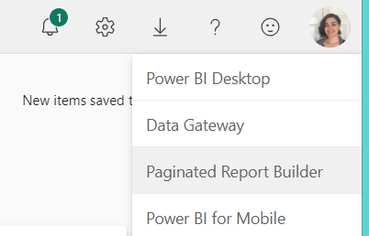
Welcome! While you wait, please…
Download Paginated/Power BI Report Builder (if you haven’t already) from Power BI.
2. Download our sample .pbix file & Starter report from my GitHub:
https://tinyurl.com/Paginated201
3. Upload that sample .pbix file to the Power BI Service to a workspace of your choosing.
WIFI: Network Name: SummitNA Password: QueenCity2023
Note: If you attended the 101 workshop, you’re all set! We’ll be picking up where we left off yesterday with our practice report.
https://tinyurl.com/3frbf26v

Slide 2
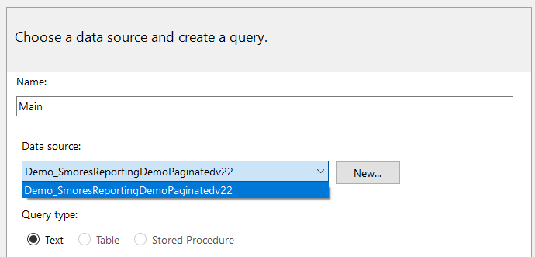
Post-Presentation note
If you’re working on the practice sections after this presentation and only attended the 201 session, please note that you’ll also need to update your data source for the paginated report dataset so it matches your Power BI workspace (rather than my own).
I mentioned this at the very beginning of the session, but it would have been easy to miss☺
Feel free to message me on LinkedIn with any questions about the practice sections and I’ll be glad to help!
-Lenore

Slide 3
Paginated Reports 201 Build a Better Report

Slide 4






@Caf2Code’s Paginated Report
101 Series
Lenore Flower
Senior BI Analyst (Data Plumber)
DC Power BI User Group Co-Organizer
/LenoreFlower

Slide 5
Quick 101 refresher
Fixing common dataset issues
Expressions
Custom Filters
Deeper dive into parameters
Dynamic Titles
More formatting
Questions & hands-on support
Concept | Demo | Practice
Notes:
Today’s session builds upon what was covered in yesterday’s 101 session, but I want to emphasize that you do *not* need to have attended the prior session to get value out of this one. 1. We’ll start with a quick 101 to refresh foundational concepts, which I’m going to try to present like the “in case you missed it” at the beginning of a TV show, with an emphasis on some of the points of confusion that can trip up more intermediate report designers
2. Then we’ll cover expressions. This is a broad topic, so I’ll be focusing on the ones I lean on the most.
3. We’ll leverage some of those expressions by creating a custom filter to add to our report
4. Next we’ll take a deeper dive into parameters, including demystifying that funky RSCUSTOMDAXFILTER
5. We’ll review how to leverage expressions to create more dynamic titles in your report, which will cover expressions and concepts that you can apply in various ways beyond just titles alone
6. And then we’ll cover more formatting (beyond what we reviewed during 101). If you attended 101 yesterday, welcome back! We’re going to be revisiting some slides from yesterday (albeit in less detail) before we build on them in each section. My goal in doing so is both to help cement the concepts and show how those foundational ideas fit into the more intermediate ideas we’ll be covering here. If this doesn’t work the way I hope it will, please let me know after the session and I’ll be glad to hear your feedback.

Slide 6

Similarities: Standard & paginated reports
 | Power BI Reports | Power BI Paginated Reports
Available to Power BI Pro users
Stored on the PowerBI.com
Can include graphs and tables
Can use Power BI dataset as source
Can leverage Row Level Security
Notes:
We’ve covered what’s different between a standard Power BI report—so what’s the same? 1. Both kinds of reports are available to Power BI Pro—this is a huge improvement from the dark ages where paginated reports were for premium only
2. Both kinds of reports can be stored in the Power BI service, and can live in harmony with each other in workspaces and apps
3. Both can include visuals such as graphs and tables
4. Both can use a Power BI dataset as their data source
5. And both can leverage row level security.

Slide 7
Paginated Power BI Reports
Standard Power BI Reports
Vs.
Core purpose: Create dynamic reports that can be interacted with on a variety of different screens.
Core purpose: provide precisely structured reports that can be reliable be viewed on a computer screen, PDF, or print out.
Empower users to explore their data while providing sophisticated options such as what-if parameters, interactive drill-downs, and AI insights.
Power BI Paginated reports are deliberately constrained to limit end user changes to pre-defined parameters.
Can export (at most) 150,000 rows to Excel from Power BI Service
Can export up to Excel’s 1M limit from Power BI Service
(Helps to) answer why
(Helps to) answer what
Notes:
This series is going to walk you though how to build that paginated report based on what was originally designed in Power BI Desktop—but before we go step-by-step, it’s important to first understand how the two tools are different.
1. First-- Why can’t Standard Power BI reports just let you print things out the way you need them? The short answer is that standard Power BI reports are optimized to fit a variety of different screens regardless of the filters and other interactive components. Basically, a standard power bi report report needs to work like spandex to passably fit everything from an iPhone to a large conference room display—that flexibility requires things like scroll bars to shrink and stretch. 2. In comparison, Paginated Power BI reports have a deliberately rigid structure to ensure that they can print or export in a specific format. Knowing how your report needs to be experienced by report users should define which tool you use for designing that report.
3. You want to use a standard Power BI report when the report’s purpose is to empower report users to explore, analyze, and interact with their data, not necessarily just with slicers and visual interactions, but also with more sophisticated options like what-if parameters and AI insights
4. In contrast, a Power BI paginated report is a good option when you only want the end user to make a few selections and get clearly-defined output
5 In other words, Standard power bi reports are great at helping an end user explore why a key metric is the way that it is
6. Where paginated reports are more interested in providing a listing of “what” those metrics are, at a predefined level of detail

Slide 8


Standard Power BI Reports
Paginated Power BI Reports
Vs.
I’ve generated your output.
End of conversation
Hi There! How can I help?
Notes:
I tend to think of Power BI paginated reports as Power BI’s older, less flashy sister.
1. If you watched “The Good Place”, you can think of Power BI standard reports as Good Janet; she’s friendly, the list of things she can do seems to be endless, and she can even offer useful insights and suggestions. 2. Paginated Reports are more like Neutral Janet from the accounting department. She’s not super friendly or full of magic tricks, but she’s often what you need to get the job done.

Slide 9

Paginated Reports work differently from Standard Power BI
 | Power BI Paginated Reports | Power BI “Standard“ reports
Report building tool | Power BI Report Builder/ Paginated Report Builder | Power BI Desktop
Origin story | SQL Server Reporting Services (2005) | Power Pivot (2010)
Native habitat | SQL | Excel
Query logic | DAX, SQL, or MDX | DAX (for visuals)
Data stored? | No | Yes
Notes:
Paginated reports and standard Power BI reports work differently in part because they evolved separately within the Microsoft ecosystem, with paginated reports starting out as SQL Server Reporting Services and Power BI standard reports starting as an Excel Add-in called Power Pivot. While I don’t have any intel on how Microsoft planned out the merging of these two tools, it seems obvious to me that some shoehorning was involved to make paginated reports fit into the Power BI ecosystem. Visual basic = object-oriented programming language that can be used in a range of Microsoft products

Slide 10

If you try to build your paginated report like you do in Power BI Desktop...
You're going to have a bad time
Notes:
We also established

Slide 11



Paginated data sources bridge the datasets
Dataset in
Power BI Service
Dataset in
Power BI Report Builder
Data Source in
Power BI Report Builder
I contain multitudes
I output a table
Notes:
If you’re aiming to use the data from a Standard power BI report in a paginated report, you accomplish this by
1- uploading the dataset to the Power BI Service
2 – defining that Power BI Dataset as the data source in power bi report builder
3 – and finally by picking the fields you want from the data source to create a dataset

Slide 12
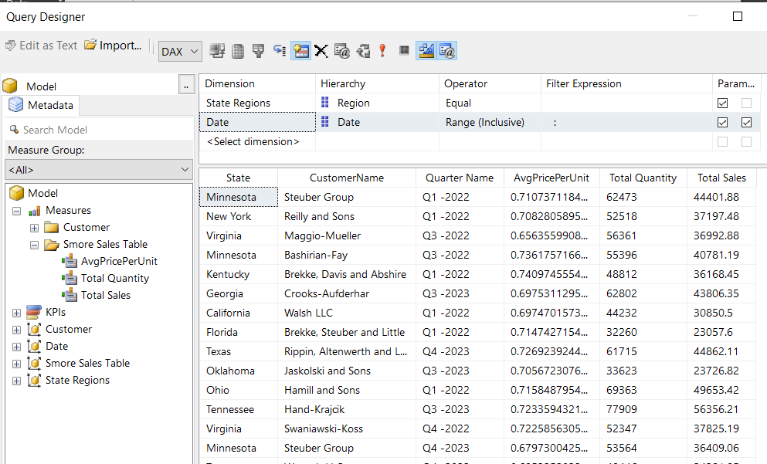
Drag and drop to build your dataset query
Needs sort field? Add sort field
Use measures; save sanity
Minimize the number of columns
Notes:
With a paginated report’s dataset the result is going to be a single table of static values. Here are a few things to keep in mind.
Remember that most logic built into your standard Power BI dataset for relationships, sorting or measures will inform what goes into the Paginated report dataset but it’s not going to carry through into the paginated report dataset.
For example, if you use a sort field to make your quarters chronological in your power bi dataset, you’ll need to pull that same field to apply sorting in your paginated report
Flattened tables aren’t as efficient as data models—your dimensional data is going to repeat for every relevant row. If you’re thinking “boy that’s going to have an impact on performance”, you are correct! This is why we want to minimize the number of fields we reference and make good use of aggregations (where appropriate), parameters and filters so we’re only pulling the data we need. If you find that you need another field in the dataset, you can always add it later.
Always use measures for any values that you want to see summed, averaged, or otherwise aggregated in your report. Paginated reports don’t employ implicit measures like Power BI Desktop does to automatically aggregate values in reports. Let’s go to Power BI desktop for a moment So I can show you what I mean

Slide 13
Query filters & query parameters
Both:
defined using the Query Editor
constrain the data pulled into the report
Query Filters: constraint will always be applied to the report Query Parameters: constraint is chosen by report user
Notes:
Filters and parameters can happen at a couple different levels within the Paginated report builder; let’s start by talking through Query Filters and Query parameters. These two are very similar; they’re both defined in the Query editor and limit what data is pulled into the report; The key difference between the two is that query filters will always be applied to the report regardless of how the user interacts with it,
In comparison query parameters let the report user choose what data is passed back to the report based on their selections. You can kind of think of parameters as filters with extra steps—which is why we’re going to cover query filters first.

Slide 14
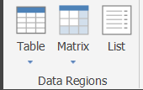
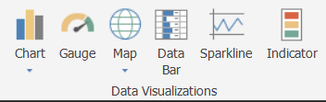
Introducing Data Regions
Data Regions
how query output is organized for report users to see
Can only use 1 dataset per data region*
Can be used individually, or in conjunction with one-another
Easy to evolve from one data region to another (but not intuitive)
*Caveat: workarounds exist! We’ll discuss one momentarily
Notes:
Paginated Reports’ Data Regions come in three flavors, Table, Matrix and List. Tables are good when your columns are static, and your rows of data may grow or shrink Lists are good when you need to incorporate data in a more free-form style, like the employee directory that Microsoft used in the paginated reports in a day training. Our report will use a Matrix, which allows the rows to expand with information about the customers and customer states AND allows the columns to expand with the quarters based on the time periods that the end user selects.
To build our matrix, I went to the “Insert” portion of the ribbon, selected the “matrix” option and chose “Insert Matrix”. When I select “Insert Matrix”, I can then click anywhere I want in the body of the report and we’ll automatically have a matrix structure setup, with both row and column groups already conveniently defined. Now I’m just going to pull the data in where I want it, with Customers’ names in the row section, the Quarter name in the Column section, and three separate data columns falling underneath the quarter column header.
When I was first working in paginated reports, I had a really hard time seeing how these different elements fit together, so I’m going to build out this matrix slowly and in roughly the same order I used when we were putting together the dataset query. As a side note, if you get stuck and frustrated building out your first matrix, you can always delete your first draft and build another—just be sure to use the “delete” button, not the backspace, which will do nothing.
Step one, I’m going to add an additional row “outside the group” in the middle so we have a spot for each value column’s name below where the Quarter values are going to go. Let’s just start with total quantity, which I’ll select from the drop down this time and run the report. There we have the start of a functional, if ugly and not particularly informative report. Step two: I’m going to add two more columns underneath the future fiscal quarter column. To do so, I’m selecting the Total Quantity column, right clicking, then selecting “Insert Column”-> inside group -> Right– let’s run it again. And then a third and final time for total sales, I’m going to do something a little different and pull the value to the right—a new column was generated automatically, and conveniently it defaulted to be within the column group.
Step three – let’s add in the Quarter in the top column– you can see that, while they’re not in the right order yet, they are getting grouped with the quantity, average price per unit and total sales, which is what we need at this stage. Finally, lets add state and customer, with customer values nested within the states. Run the data one last time and you can see all the states, customers, and fiscal quarters listed—even if they’re not quite in the order or format we want

Slide 15

Cross-join conundrum Or: hey why did my query explode?
Scenario: you need to build a paginated Power BI report that includes the product sold to each customer, an easy report to build in Power BI Desktop.
You try to create a query with just data from the dimProduct and dimCustomer tables from your Power BI dataset and your report promptly crashes.
Notes:
Sometimes you need to populate data in a report that uses just dimensional data from two different dimensions

Slide 16
What happened?
Dim Product
Fact
Sales
Dim
Customer
Notes:
So what happened? You’d think that building up a query in Paginated report builder would have the same mechanics as building up a table visual in Power BI desktop—it certainly feels the same. But even though Query Designer and PBI Report Visuals both generate DAX to support the resulting table output, the logic is quite different.
When a Power BI dataset functions as a paginated report’s data source, the dimensions have no relationship except where a fact field joins the two. In this case, the dim employee and dim PayTypes don’t have a relationship with each other and will instead just repeat every single value associated with both dimensions like a cross join in SQL.

Slide 17

Solution: add a “hinge” measure
Fact
Sales
Dim Product
Dim
Customer
Notes:
The solution—counterintuitive as it seems—is to add a measure from the fact table that can function as a hinge between the two dimension tables. Bringing a relevant measure into play will eliminate the “does not compute” element from the query, eliminating the cross-filter issue

Slide 18

Why am I getting so many rows?
Scenario: You’re building out a paginated report using a Power BI dataset and just need summed values based on the dimension fields you select—but instead, you’re getting a ridiculous number of rows—way more than when you built a similar report in Power BI standard.
What’s happening?

Slide 19

I need different information that isn’t available from my data source
Scenario: your company just changed the regional naming conventions and needs the reports updated to match right away. Your underlying data sources are going to take some time to catch up.
Solution: Use an “Enter Data” Data Source and the Lookup Expression!

Slide 20
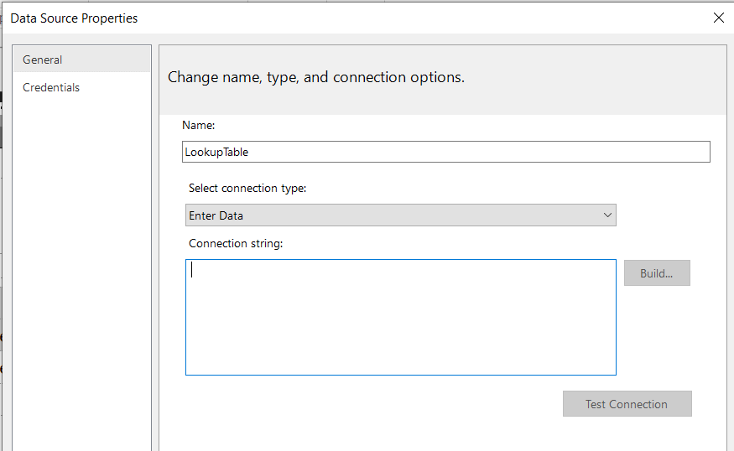
Introducing the Lookup expression
=Lookup(source_expression, destination_expression, result_expression, dataset)
Old Regional Structure | New Division Structure
Midwest | Midwestern Division
Northeast | Mid-Atlantic Division
South | Southern Division
West | Western Division

Slide 21
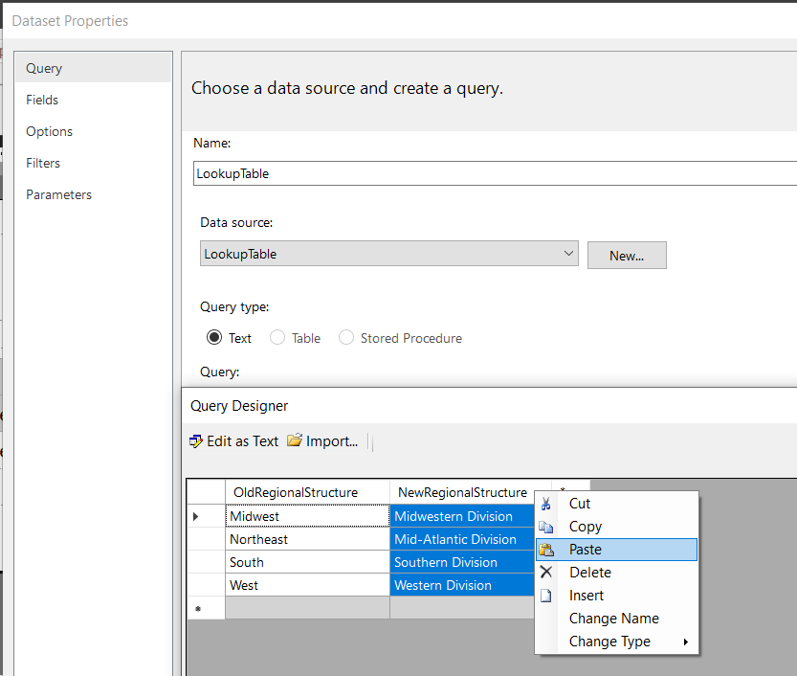
Introducing the Lookup expression
=Lookup(Fields!Region.Value,Fields!OldRegionalStructure.Value,Fields!NewDivisionStructure.Value, "LookupDataset")
Old Regional Structure | New Division Structure
Midwest | Midwestern Division
Northeast | Mid-Atlantic Division
South | Southern Division
West | Western Division

Slide 22
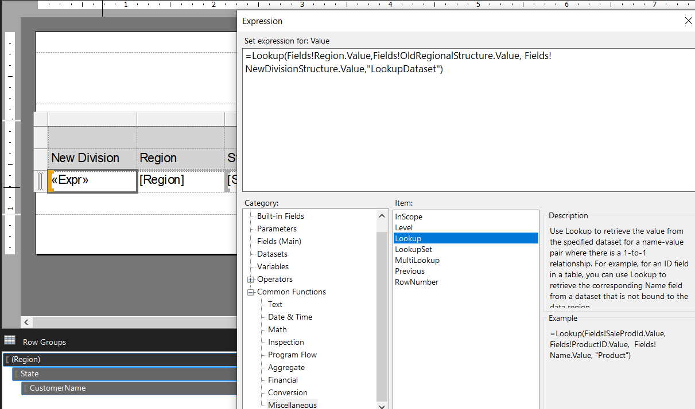
Introducing the Lookup expression
=Lookup(Fields!Region.Value,Fields!OldRegionalStructure.Value,Fields! NewDivisionStructure.Value, "LookupDataset")
Old Regional Structure | New Division Structure
Midwest | Midwestern Division
Northeast | Mid-Atlantic Division
South | Southern Division
West | Western Division

Slide 23

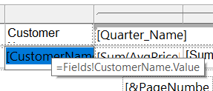
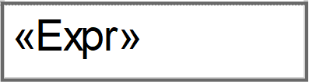

Expressions in Paginated Reporting
Written with Visual Basic, not DAX (Data Analytics Expressions)
Simple Expressions show up with [Brackets].
Complex Expressions will present as <<Exp>> when used in a textbox or Tablix
Can be used in (just about) every element of your paginated report
Notes:
Expressions in Paginated Reporting function as the underpinning of most of the report body– and in fact, if you’ve built anything using paginated report builder, you’re already using expressions.

Slide 24
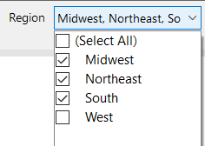
Handy Expressions: Text Manipulation
=Join()
Example = Join(Parameters!Region.Value,", ")
Output = “Midwest, Northeast, South”
=InStr
Example= InStr(Join(Parameters!Region.Value,", "),",")
Output = 8
=InStrRev
Example= InStrRev(Join(Parameters!Region.Value,", "),",")
Output = 7
Notes:
Join enables you to get the output from a parameter and –at your option, define a delimiter to separate out each of those values like I did above with a comma and a space. In this case, I would have selected three region values in the example above, resulting in an output of South “comma space” Midwest Comma space, north InStr (or in string) works like the =Find() formula in Excel or DAX and will output the location of a specific value
InStrRev (in string reverse) performs the same task of it’s sibling InStr, but starts from the end of a text string and searches from right to left

Slide 25
Handy Expressions: Text Manipulation (Many are the same as Excel!)
=Left(“Paginated”,3)
Output: Pag
=Right(“Paginated,3)
Output: ted
=Len(“Paginated”)
Output: 9
Concatenate with “&”
=[SpeakerName]&”Loves”&[Topic]&”!”
=[SpeakerName]&” Loves ”&[Topic]&”!”
=Lenore Loves Paginated Reports!
=LenoreLovesPaginated Reports!
Notes:
As subset of expressions are also readily available in

Slide 26
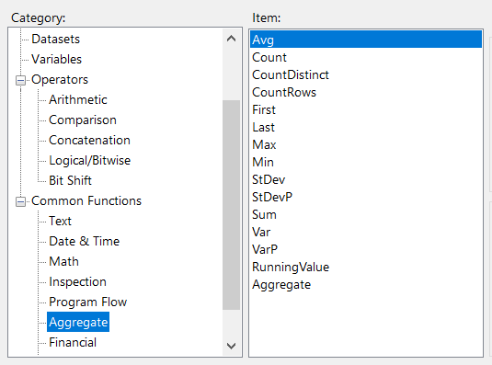
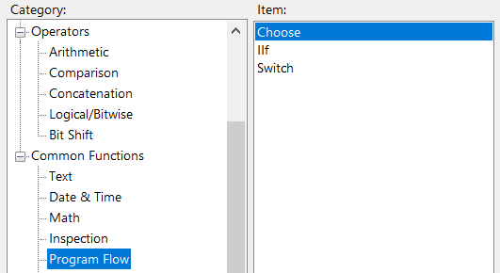
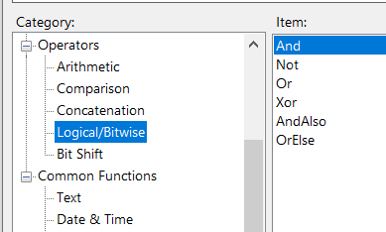
Handy Expressions: Calculations & Conditionals
Calculation Classics, like: =Sum() =Min()
=Max()
=Round()
Conditional =Iif()
=Switch()
=And() =Or()
Notes:
Note: Switch is a nice alternative to the lookup expression if you have a small list of

Slide 27
Handy Expressions: Date
Expression | Output
= Today() | 10/19/2023 12:00:00 AM
= Now() | 10/19/2023 2:45:13 PM
= Year(Today()) | 2023
= Month(Today()) | 10
= MonthName(Month(Today())) | October
=Day(Today) | 19
Notes:
We’ll go into some additional date and time expressions later in this session, but here are some common Date-related expressions I rely on, both on their own and as building blocks for more complex date-related outputs. Many of these probably look familiar to you already from Either DAX or Excel

Slide 28
Adding A Custom Query Filter
Filter For: | Custom Expression
Current year (normal view) | 'Date'[Year] = YEAR(TODAY()))
Current year (expanded) | 'Date'[Year] = YEAR( TODAY() )
This year & Last Year | 'Date'[Year] =YEAR( TODAY() ) || Date'[Year] =YEAR( TODAY() ) -1)
Or
Less 1 year
Notes:
A filter that is hard coded to a specific calendar year may meet your needs today, but what happens on Jan 1 2024 when you’ve got 20 YTD reports that all need to be updated. Do you want to do all those manual fixes? Will you even remember? Of course not! This is where Custom Query Filters come in handy. The two I’m including are the ones I assume will be most useful based on my work experiences, but Visual Basic gives you a wide variety of options to customize these

Slide 29
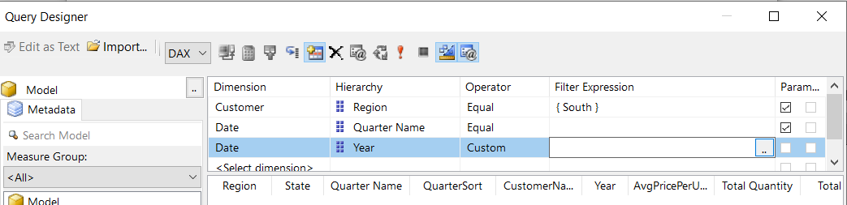
Your Turn!
Right click on your Main Dataset and select:
->Dataset Properties
-> Query Designer
2. Create a Custom Expression using the following logic:
'Date'[Year] = YEAR(TODAY()))
3. Test the output by selecting “click to execute the query” in the query designer. You should only see quarters from the current year in your output. 4. Try adding the second half of the custom query using the || (pipe) to create an oe statement: || Date'[Year] =YEAR(TODAY()) -1) 5. select “click to execute the query” again to see how your output has changed

Slide 30
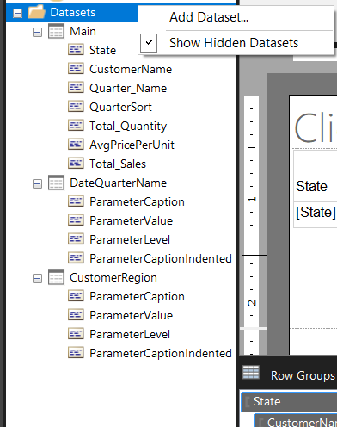
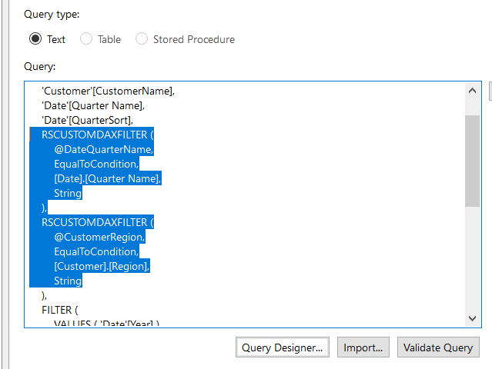
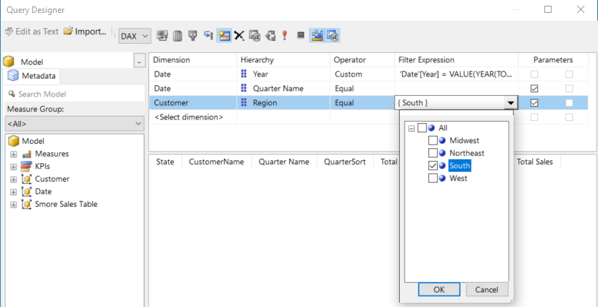
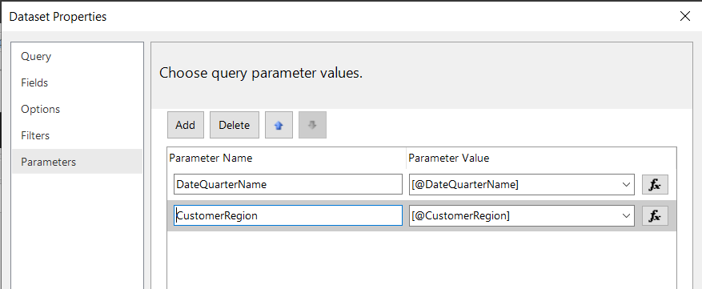
Understanding the Parameter Relay Race Query Parameters
2.
3.
1.
Notes:
You create a query parameter in almost the exact same way you create a Query Filter—you just check the parameter box (or boxes) to tell the Query designer that you want report users to be able to control the input. To enable report users to choose the input, the Query Designer applies the following five steps: 1 – the corresponding DAX is generated for the query, and
2 – the parameters are defined under dataset properties, and
3 – a hidden dataset is auto-generated to support the report parameter, and
4 – the report parameter properties are defined for each parameter, and
5 – the drop-down selection is added to the parameters pane. Together, these five steps create a kind of relay race from where the report users select the parameters, back to the query, and then boomerangs with the data back into the report. Let’s see it in action.

Slide 31
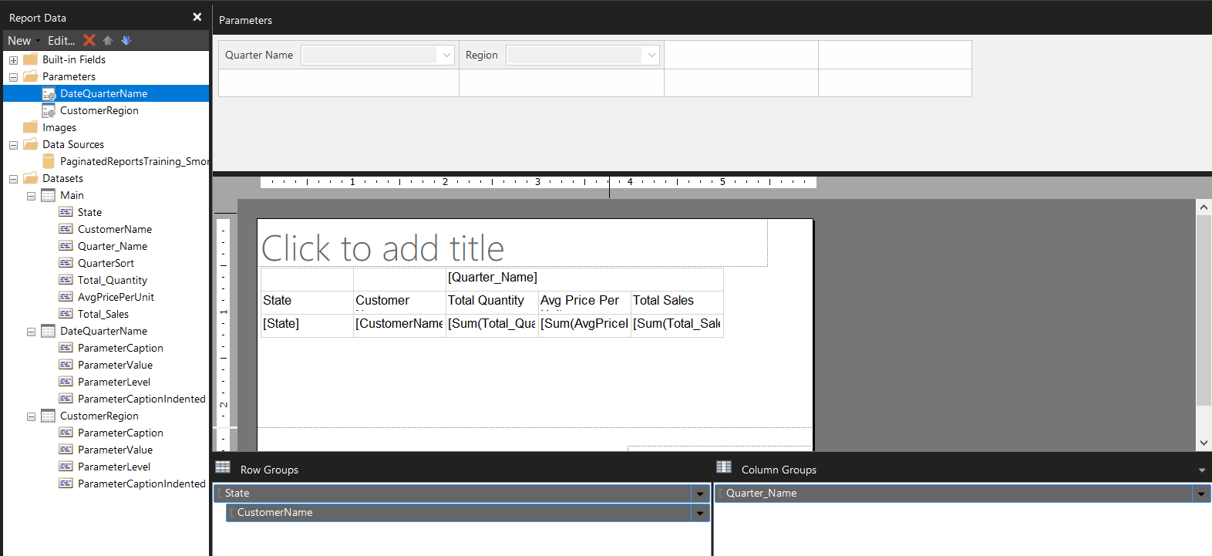
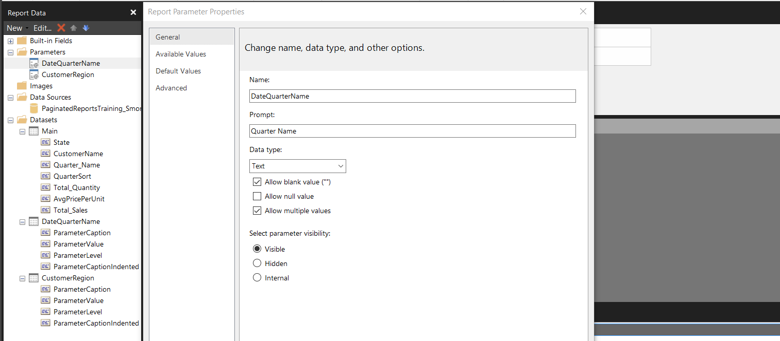
The Parameter Relay Race Report Parameters
5.
4.
Notes:
You create a query parameter in almost the exact same way you create a Query Filter—you just check the parameter box (or boxes) to tell the Query designer that you want report users to be able to control the input. To enable report users to choose the input, the Query Designer applies the following five steps: 1 – the corresponding DAX is generated for the query, and
2 – the parameters are defined under dataset properties, and
3 – a hidden dataset is auto-generated to support the report parameter, and
4 – the report parameter properties are defined for each parameter, and
5 – the drop-down selection is added to the parameters pane. Together, these five steps create a kind of relay race from where the report users select the parameters, back to the query, and then boomerangs with the data back into the report. Let’s see it in action.

Slide 32
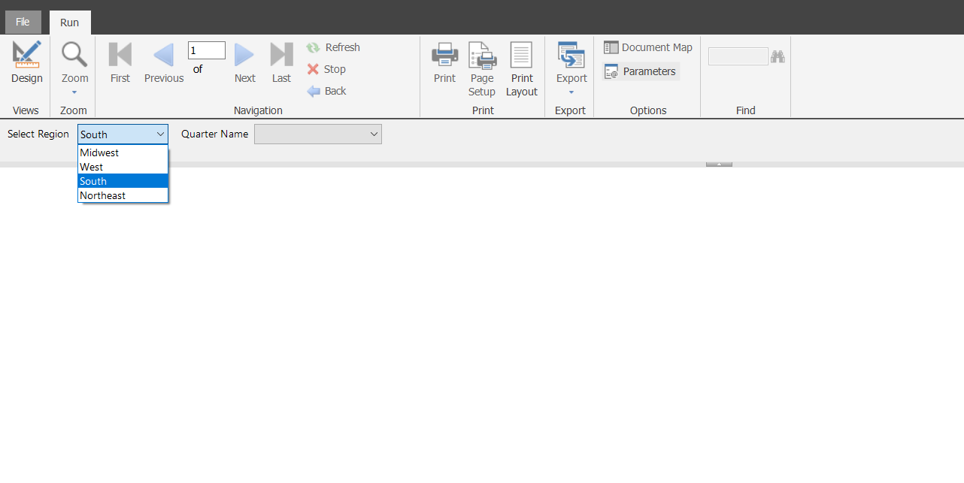
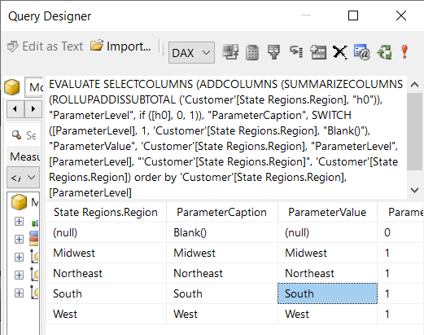
The Parameter Relay Race User Selection at Run-time
1. Report Parameter list is generated from hidden dataset query
2. Report user selects the parameter(s) and runs the report
Parameters!Region.Value
=“South”
Notes:
Let’s start by briefly walking through what happens when a report parameter is selected at run-time, which will provide some useful context for the mechanics we’ll cover next. 1. Here in our report, we have a drop-down list of four available regions. These are sourced from a hidden dataset query that was automatically generated to support this report parameter. 2. When the report user selects a parameter and runs the report, his selection of “South” becomes the value for Parameters!Region.Value

Slide 33
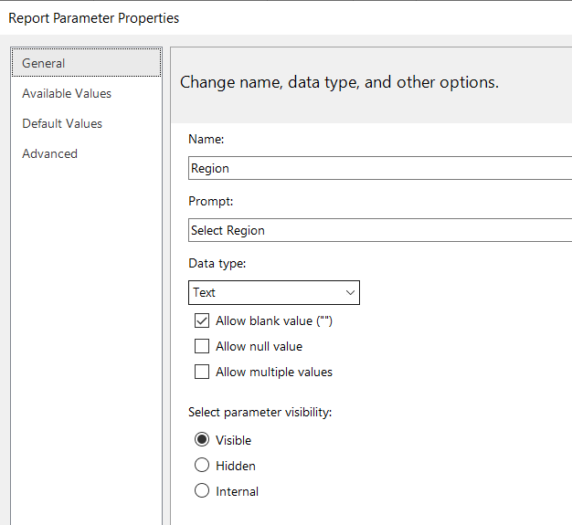
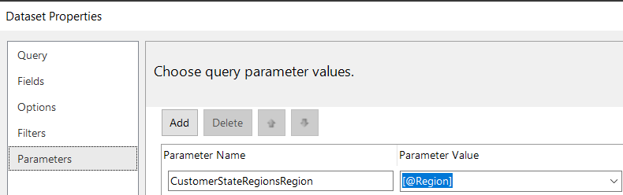
The Parameter Relay Race User selection is fed back to the query
(in the dataset query)
(from the report)
RSCustomDaxFilter( @CustomerStateRegionsRegion, EqualToCondition, [Customer].[StateRegions.Region], String )
=Parameters!Region.Value
“South”
Data Type: Text
Parameters!Region.Value
=“South”
Notes:
That South value is defined as Data type text using the report parameter properties,
and then it’s matched up with the Query parameter under dataset properties.
The parameter value from the report populates on the right of the Query Parameters section of the Dataset Properties
Where the dataset query values are assigned on the left. I’ve written out the components of both so you can see how they tie together. The key thing to remember here is that the report parameter output needs to match the expected query parameter output for this to work. For example, if the query value is set up to expect single value but you’ve turned on “allow multiple values” in the report parameter, the query parameter and report parameter won’t match and the report may break. Thankfully that RSCustomDax filter allows for both single and multiple values, so that won’t be a problem. Similarly if your query parameter is defined to be data type string but your report parameter is defined as data type date or integer, you’ll most likely get an error when you try to run the report.

Slide 34

What’s the deal with RSCUSTOMDAXFILTER?
“it’s just a placeholder for a dynamically-generated DAX expression that is substituted in at runtime…Handling multi-value parameters is difficult in DAX when you don’t know how many values are going to be passed to the parameters”
-Chris Webb (blog.crossjoin.co.uk)

Slide 35
Query Designer-Generated DAX Script (Just Region)
Equivalent DAX Script
(Just Region)
@CustomerRegion = South
EVALUATE SUMMARIZECOLUMNS ( 'Customer'[State], 'Customer'[CustomerName], 'Date'[Quarter Name], 'Date'[QuarterSort], RSCUSTOMDAXFILTER ( @CustomerRegion, EqualToCondition, [Customer].[Region], String ), "AvgPricePerUnit", [AvgPricePerUnit], "Total Quantity", [Total Quantity], "Total Sales", [Total Sales] )
EVALUATE SUMMARIZECOLUMNS ( 'Customer'[State], 'Customer'[CustomerName], 'Date'[Quarter Name], 'Date'[QuarterSort], FILTER ( ’Customer’, ’ Customer’[Region] = @CustomerRegion ), "AvgPricePerUnit", [AvgPricePerUnit], "Total Quantity", [Total Quantity], "Total Sales", [Total Sales] )
Notes:
Here’s the output from the query designer with its equivalent using DAX that I wrote. Because this report is set to just include 1 value for this customer region parameter, the RSCUSTOMDAXFILTER is doing the same thing as a FILTER() DAX Function would be

Slide 36
Query Designer-Generated DAX Script (Just Region)
Equivalent DAX Script
(Just Region)
@CustomerRegion = South
EVALUATE SUMMARIZECOLUMNS ( 'Customer'[State], 'Customer'[CustomerName], 'Date'[Quarter Name], 'Date'[QuarterSort], RSCUSTOMDAXFILTER ( ”South”, EqualToCondition, [Customer].[Region], String ), "AvgPricePerUnit", [AvgPricePerUnit], "Total Quantity", [Total Quantity], "Total Sales", [Total Sales] )
EVALUATE SUMMARIZECOLUMNS ( 'Customer'[State], 'Customer'[CustomerName], 'Date'[Quarter Name], 'Date'[QuarterSort], FILTER ( ’Customer’, ’Customer’[Region] = “South” ), "AvgPricePerUnit", [AvgPricePerUnit], "Total Quantity", [Total Quantity], "Total Sales", [Total Sales] )
Notes:
When the report parameter is passed back, it’s the same thing as the value “South” being coded into DAX script itself. Pretty straightforward

Slide 37
Query Designer-Generated DAX Script (1 Quarter)
Equivalent DAX Script
(1 Quarter)
@DateQuarterName = Q1-2022
EVALUATE SUMMARIZECOLUMNS ( 'Customer'[State], 'Customer'[CustomerName], 'Date'[Quarter Name], 'Date'[QuarterSort], RSCUSTOMDAXFILTER ( @DateQuarterName, EqualToCondition, [Date].[QuarterName], String ), "AvgPricePerUnit", [AvgPricePerUnit], "Total Quantity", [Total Quantity], "Total Sales", [Total Sales])
EVALUATE SUMMARIZECOLUMNS ( 'Customer'[State], 'Customer'[CustomerName], 'Date'[Quarter Name], 'Date'[QuarterSort], FILTER ( Date, Date[QuarterName] = @DateQuarterName ), "AvgPricePerUnit", [AvgPricePerUnit], "Total Quantity", [Total Quantity], "Total Sales", [Total Sales])
Notes:
Our other parameter for this report will be quarters (plural), meaning that the Query parameter needs to be able to pass back multiple values. This is where the RSCUSTOMDAXFILTER really comes in handy
If someone happens to just choose one quarter, the RSCUSTOMDAXFILTER will still create a filter

Slide 38
Query Designer-Generated DAX Script (multiple quarters)
Equivalent DAX Script
(Multiple quarters)
@DateQuarterName = Q1-2022, Q2-2022, Q3-2022, Q4-2022, Q1-2023, Q2-2023
EVALUATE SUMMARIZECOLUMNS ( 'Customer'[State], 'Customer'[CustomerName], 'Date'[Quarter Name], 'Date'[QuarterSort], Filter('Date', 'Date'[Quarter Name] = "Q1-2022" || 'Date'[Quarter Name] = "Q2-2022" || 'Date'[Quarter Name] = "Q3-2022" || 'Date'[Quarter Name] = "Q4-2022" || 'Date'[Quarter Name] = "Q1-2023" || 'Date'[Quarter Name] = "Q2-2023" ), "AvgPricePerUnit", [AvgPricePerUnit], "Total Quantity", [Total Quantity], "Total Sales", [Total Sales])
EVALUATE SUMMARIZECOLUMNS ( 'Customer'[State], 'Customer'[CustomerName], 'Date'[Quarter Name], 'Date'[QuarterSort], RSCUSTOMDAXFILTER ( @DateQuarterName, EqualToCondition, [Date].[QuarterName], String ), "AvgPricePerUnit", [AvgPricePerUnit], "Total Quantity", [Total Quantity], "Total Sales", [Total Sales])
Notes:
In a scenario where 2 or more quarters are selected becomes more complex, however, we can’t just use that filter and an equals sign and call it a day. The DAX needs to morph to become more like this – which is essentially what the RSCUSTOMDAXFILTER is doing on your behalf—it’s generating different variations of the filter function based on the selections made at report runtime.

Slide 39
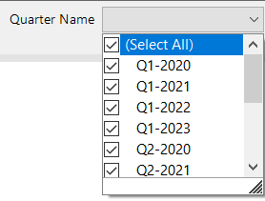
Getting your parameters to default to all values
Scenario: A report user requests that the report defaults to “All” for each parameter so that all values will automatically generate when a report is selected.
Weirdly, there’s no parameter property for this.
….how do you make this work?

Slide 40
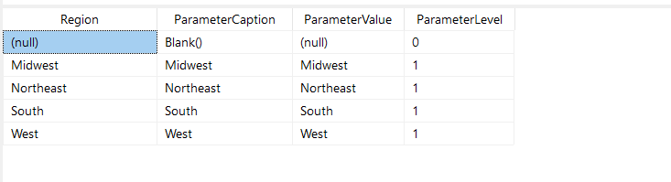
Getting your parameters to default to all values
Solution: Tweak the underlying datasets that were auto-generated to support your parameters. The auto-generated dataset is applying a hierarchy, which is getting in the way of that default select-all

Slide 41
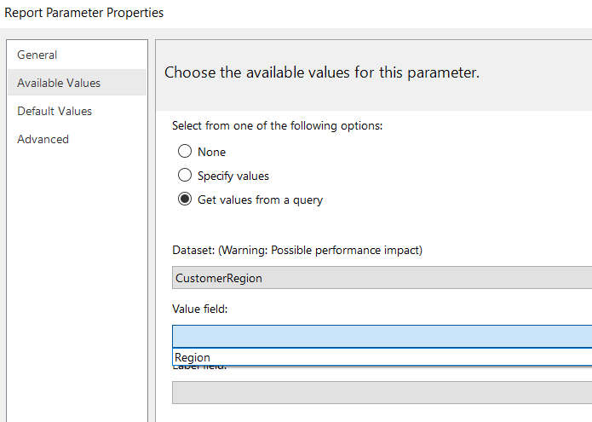
Your turn!
1. Right click on each of your parameter’s datasets to open the Dataset Property window.
2. Under Fields, delete the field named “ParameterCaptionIndented”
3. Replace the auto-generated query by going to “Design mode” in the Query Designer and adding just the single field you want to use for your dropdown parameter.
The resulting query will be similar to:
EVALUATE SUMMARIZECOLUMNS('Customer'[Region])
4. Under Parameter Properties, update the “Available Values” to match the new field name you’ve created.
5. Run your dataset to confirm that it updates successfully.

Slide 42
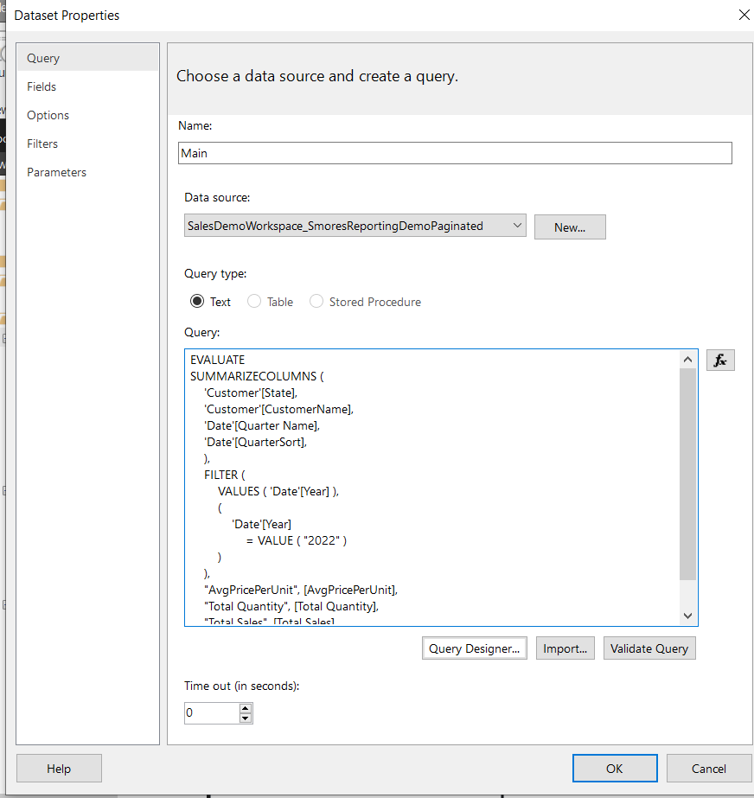
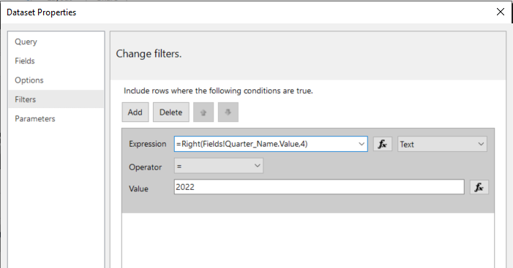
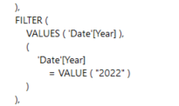
Dataset Filters
Query Filters
Vs.
Applied after a query is run
(less efficient)
Notes:
<> Query Filters
Applied After the query is run
Assigned under the “Filters” section of your Dataset’s Properties

Slide 43
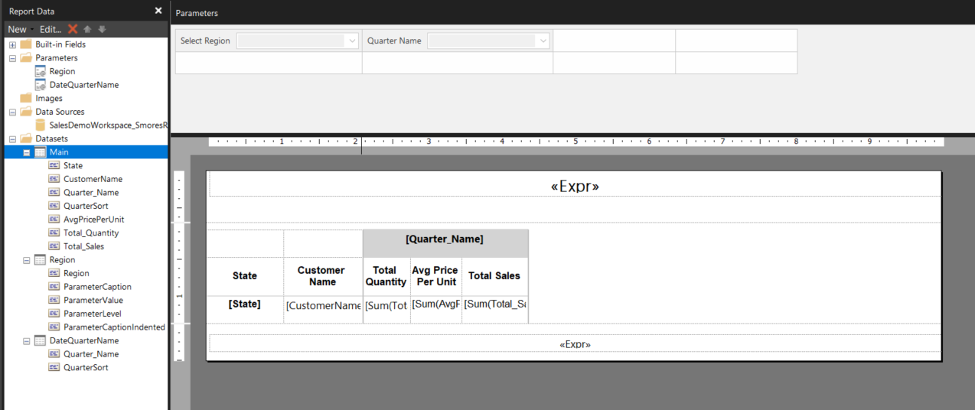
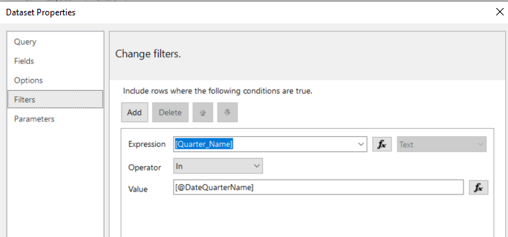
Dataset Filters can mimic query parameters
Notes:
Dataset Filters can masquerade as parameters by setting up the report parameters in the same way you might for a query parameter, then using the Filters under dataset properties to set up the value to reference the report parameter (in this case, [@DataQuarterName]. Here I’m using the IN operator to allow for multiple values to be carried from in the report parameters to the dataset filter

Slide 44
…Should I use a Dataset Filter instead of a Query Parameter?
Short Answer: probably not
Longer Answer: you can…
Whether you should depends on what kind of reporting experience you’re trying to optimize for.

Slide 45
Use a Query Parameter (instead of a Dataset Filter), unless
1. You expect report users to run multiple versions of the report at one time,
and
2. You want to minimize the refresh time between report versions,
and
3. You are ok with having the initial report load be slower due to all values initially loading at once

Slide 46
Setting up Date Parameters
Scenario 1: You want report users to be able to select a range of dates using date pickers
TILE / HEADER
Basic Steps:
…more than you would think

Slide 47
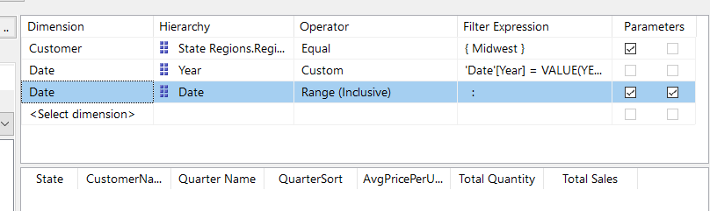
Setting up Date Parameters
1. Add date with Range (Inclusive) to the Query Parameters
BEHOLD
Notes:
First step is pretty straight-forward: choose the inclusive date range.
Remember yesterday when some of you were wondering why we had two check boxes rather than just the one? Selecting a date range may be the first time that you see the second parameter option light up. Do you see it? Here– let me make it more obnoxious for you

Slide 48

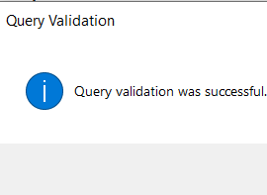

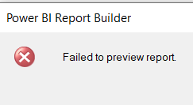
2. Validate the query
3. Test run the report
The report fails
The report fails
Notes:
You’d think this would just work, right? Most of the time my new date parameter will fail. What gives?

Slide 49
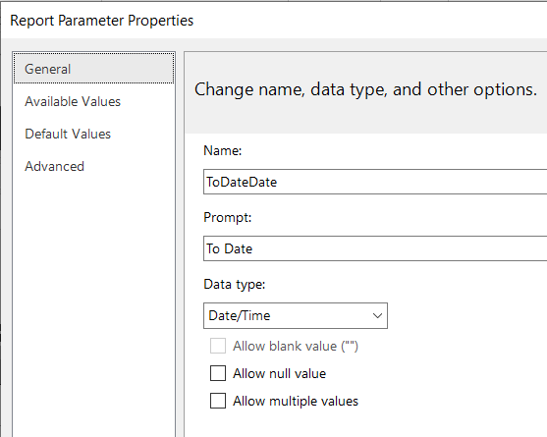
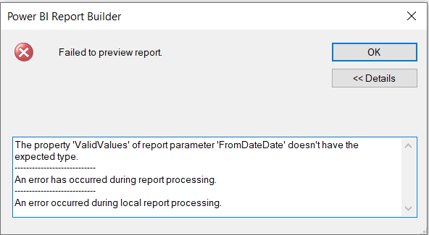
What Happened?
The Query script expects formatted date strings
But the report parameter is feeding the query script date/time
DEFINE VAR vFromDateDate1 = IF(PATHLENGTH(@FromDateDate) = 1, IF(@FromDateDate <> "", @FromDateDate, BLANK()), IF(PATHITEM(@FromDateDate, 2) <> "", PATHITEM(@FromDateDate, 2), BLANK()))
VAR vFromDateDate1ALL = PATHLENGTH(@FromDateDate) > 1 && PATHITEM(@FromDateDate, 1, 1) < 1
VAR vToDateDate1 = IF(PATHLENGTH(@ToDateDate) = 1, IF(@ToDateDate <> "", @ToDateDate, BLANK()), IF(PATHITEM(@ToDateDate, 2) <> "", PATHITEM(@ToDateDate, 2), BLANK()))
VAR vToDateDate1ALL = PATHLENGTH(@ToDateDate) > 1 && PATHITEM(@ToDateDate, 1, 1) < 1
EVALUATE SUMMARIZECOLUMNS('Customer'[State], 'Customer'[CustomerName], 'Date'[Quarter Name], 'Date'[QuarterSort], RSCustomDaxFilter(@CustomerStateRegionsRegion,EqualToCondition,[Customer].[State Regions.Region],String), FILTER(VALUES('Date'[Date]), (vFromDateDate1ALL || 'Date'[Date] >= DATEVALUE(vFromDateDate1) + TIMEVALUE(vFromDateDate1)) && (vToDateDate1ALL || 'Date'[Date] <= DATEVALUE(vToDateDate1) + TIMEVALUE(vToDateDate1))), FILTER(VALUES('Date'[Year]), 'Date'[Year] = VALUE(YEAR(TODAY())) || VALUE(YEAR(TODAY())-1)
), "AvgPricePerUnit", [AvgPricePerUnit], "Total Quantity", [Total Quantity], "Total Sales", [Total Sales])
Notes:
From the blog: “Using Date Pickers in Power BI Report Builder (coeo.com)” Notice how the query uses DATEVALUE and TIMEVALUE DAX functions to return date and time values for the specified dates (i.e. the two date parameters), which it then uses to compare and filter the data in the date dimension table (FirstPeriodDates). This tells us that the dates passed into the DAX query should be passed as formatted date strings to enable the model to convert those strings into datetime values.

Slide 50
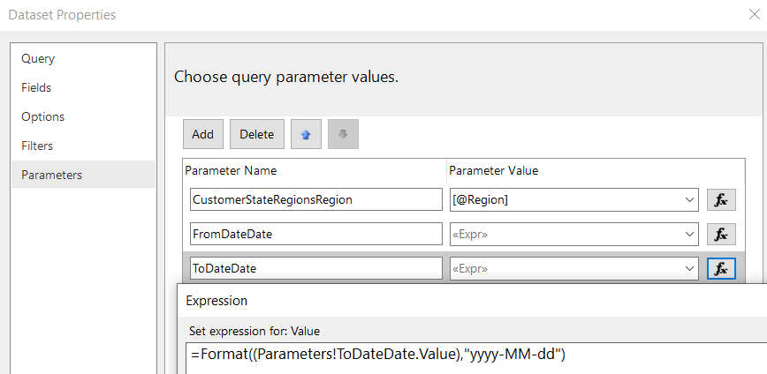
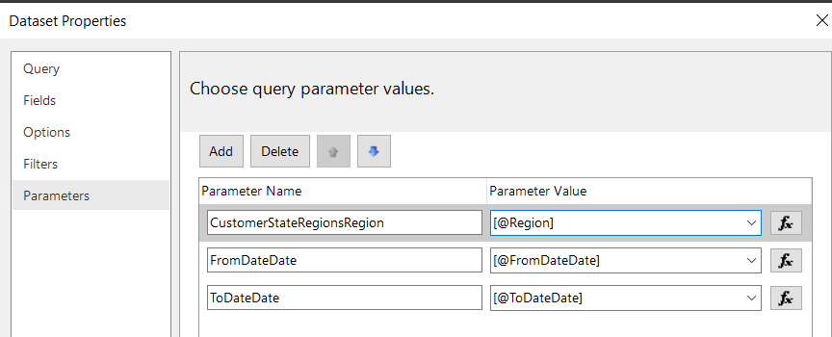
Setting up Date Parameters: Take Two
Add date with Range (Inclusive) to the Query Parameters
Update the Report Parameter Values under Dataset Properties from the default @Parameter value…
…to a formatted date string
Notes:
For our date parameters to work correctly as date pickers, we need our report parameters to present as data type date/time AND we need them to be fed back to the Main dataset as data type “string” so they work in the auto-generated script.

Slide 51
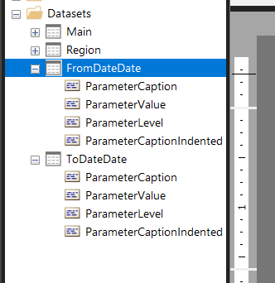
Setting up Date Parameters: Take Two
3. Delete the hidden FromDateDate & ToDateDate datasets (you won’t need them)
Notes:
For our date parameters to work correctly as date pickers, we need our report parameters to present as data type date/time AND we need them to be fed back to the Main dataset as data type “string” so they work in the auto-generated script.

Slide 52
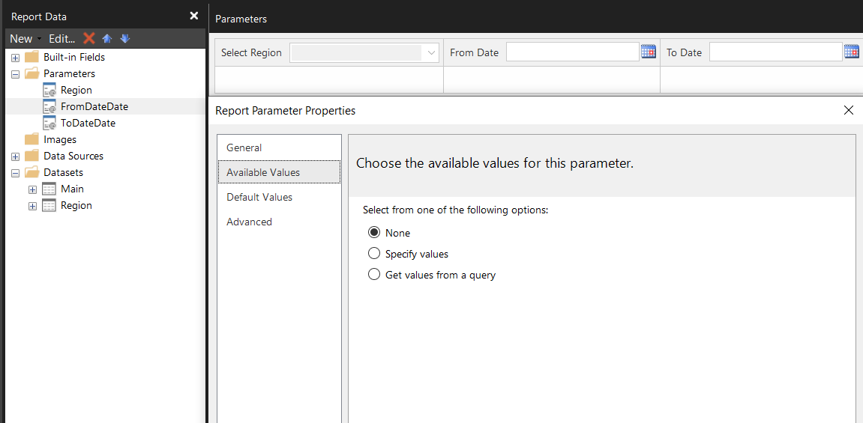
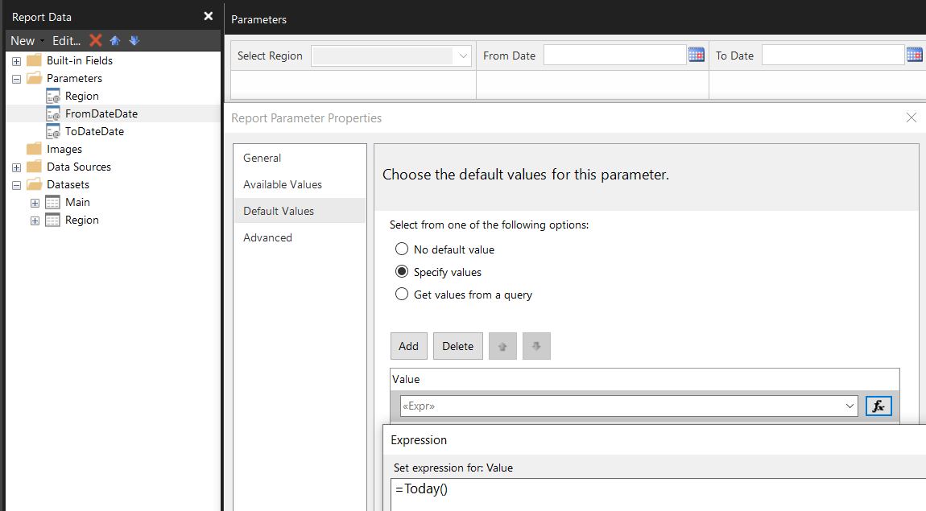
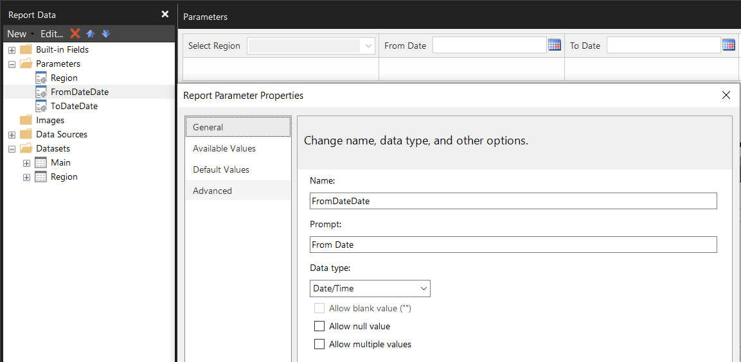
Setting up Date Parameters: Take Two
4. Update your Report Parameter Properties so that Data Type: Date/Time,
Available Values: None,
and Default Values = whatever works best for your report
Notes:
For our date parameters to work correctly as date pickers, we need our report parameters to present as data type date/time AND we need them to be fed back to the Main dataset as data type “string” so they work in the auto-generated script.

Slide 53
Your turn!
Add date with Range(Inclusive) to the Query Parameters
Update the Report Parameter Values under Dataset Properties from the default @Parameter values to:
=Format((Parameters!ToDateDate.Value),”yyyy-MM-dd”) and
=Format((Parameters!FromDateDate.Value),”yyyy-MM-dd”)
3. Delete the hidden FromDateDate & ToDateDate datasets (you won’t need them)
4. Update your Report Parameter Properties so that Data Type: Date/Time, Available Values = None, and Default Values =Today()

Slide 54
Handy Expressions for Default Dates
To get the following output in your report | Use this Expression in Paginated Report Builder
Today’s Date | =Today()
Six Months from today (+) | =DateAdd(DateInterval.Month, 6,Today())
Six months ago (-) | =DateAdd(DateInterval.Month, -6,Today())
First day of the current Calendar Year | =DateSerial(Year(today()),01,01)
Last day of the current Calendar Year | =DateSerial(Year(today()),12,31)
Note: while Today() is a common reference point, you can easily replace it with another value (e.g., a date parameter)

Slide 55
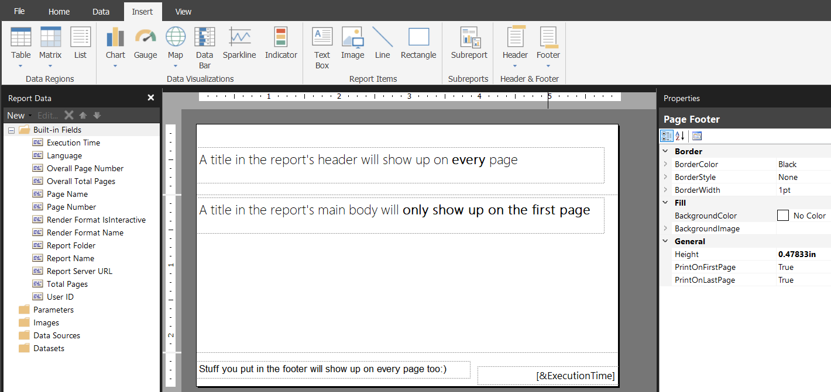
Adding a Static Title
Notes:
Often you’ll just want a static title on the first page of the report, and that’ll be good enough. 1. Under other circumstances, you’ll want the title to show up on every page, which is where you’ll want to add a header. You can accomplish this by going to “Insert”->Header->Add Header. If you’ve already written a title, that you want to show up on every page, you can drag that text box into the header and it will show up accordingly. 2. The footer acts similarly to the header– anything you put there will also show up on every page, unless explicitly set the properties to exclude the footer for the first or last page, which is what I’ve highlighted with that green box on the right hand side

Slide 56
What if you want a Dynamic Title?
Title for just one selection:
= "Quarterly Report for the " & Parameters!Region.Value(0) & “ Sales Region” Output:
Quarterly Report for the Midwest Sales Region
TILE / HEADER
Notes:
Sometimes a static title is exactly what you need—but what about when you need a dynamic title that

Slide 57
One or many values
= IF(Parameters!Region.Count = 1,
"Quarterly Report for the " & Parameters!Region.Value(0) & " Sales Region",
"Quarterly Report for the " & Join(Parameters!Region.Value,", ") & " Sales Regions“
)
TILE / HEADER

Slide 58
One or many values
= IF(Parameters!Region.Count = 1,
"Quarterly Report for the " & Parameters!Region.Value(0) & " Sales Region",
"Quarterly Report for the " & Join(Parameters!Region.Value,", ") & " Sales Regions”)
TILE / HEADER

Slide 59
One or many values
= IF(Parameters!Region.Count = 1,
"Quarterly Report for the " & Parameters!Region.Value(0) & " Sales Region",
"Quarterly Report for the " & Join(Parameters!Region.Value,", ") & " Sales Regions”)
TILE / HEADER

Slide 60
What if you want an “All”?
Basic logic to define when all parameters are selected: =IF(CountRows("Region")=Parameters!Region.Count,
“Quarterly Report for All Regions”, (…)
TILE / HEADER
Important!: CountRows doesn’t work well with auto-generated parameter datasets.
Notes:
Sometimes you want a title output that specifies all regions

Slide 61
Comma Delimited with “and”
=Join(Parameters!Region.Value,", ")
TILE / HEADER
Midwest, South, and Northeast

Slide 62
Comma Delimited with “and”
=Join(Parameters!Region.Value,", ")
TILE / HEADER
Midwest, South,
and
Northeast
Full list less the last value (using last comma)
Isolate the last value in the text string (using last comma)
=LEFT( Join(Parameters!Region.Value,", "), InStrRev(Join(Parameters!Region.Value,","),",") )
= Right(
Join(Parameters!Region.Value,", "),
Len(Join(Parameters!Region.Value,", "))-InStrRev(Join(Parameters!Region.Value,", "),",")))
& “ and“ &

Slide 63
Quarterly report for the Midwest, South, and Northeast Sales Regions
= "Quarterly Report for the "
& LEFT(Join(Parameters!Region.Value,", "), InStrRev(Join(Parameters!Region.Value,", "),","))
& " and"
& Right(
Join(Parameters!Region.Value,", "),
Len(Join(Parameters!Region.Value,", "))-InStrRev(Join(Parameters!Region.Value,", "),","))
& " Sales Regions"

Slide 64
Quarterly report for the Midwest and Northeast Sales Regions
= "Quarterly Report for the "
& LEFT(Join(Parameters!Region.Value,", "), InStrRev(Join(Parameters!Region.Value,", "),",") -1)
& " and"
& Right(
Join(Parameters!Region.Value,", "),
Len(Join(Parameters!Region.Value,", "))-InStrRev(Join(Parameters!Region.Value,", "),","))
& " Sales Regions"
Removes the last comma

Slide 65
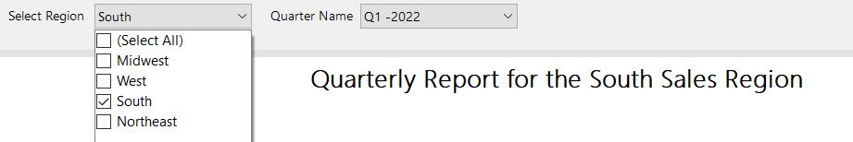
Putting it all together: If Statement One
=IF(Parameters!Region.Count = 1, "Quarterly Report for the " & Parameters!Region.Value(0) & " Sales Region",

Slide 66
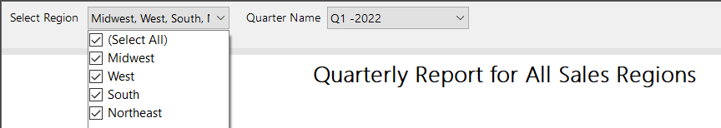
Putting it all together: If Statement Two
IF( CountRows("Region")=Parameters!Region.Count, "Quarterly Report for All Sales Regions",

Slide 67
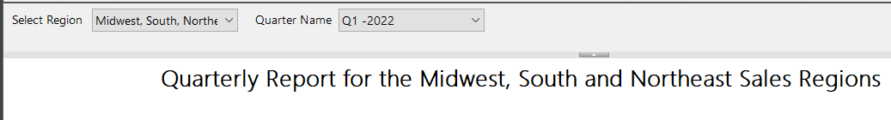
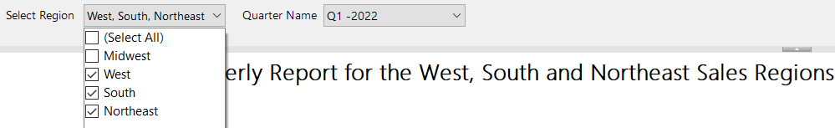
Putting it all together: Else Statement
"Quarterly Report for the " & LEFT(Join(Parameters!Region.Value,", "), InStrRev(Join(Parameters!Region.Value,", "),",") -1) & " and" & Right(Join(Parameters!Region.Value,", "),
Len(Join(Parameters!Region.Value,", ")) , InStrRev(Join(Parameters!Region.Value,", "),",")) & " Sales Regions"

Slide 68
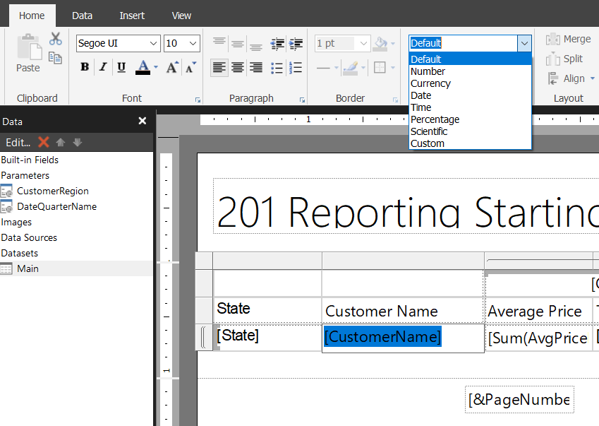
Basic Formatting
Selecting Text in a text box will let you adjust the font, indenting, and data type

Slide 69

Basic Formatting
Selecting the Textbox itself expands the formatting options to include borders and fillers

Slide 70
Basic Formatting
Merge becomes available when you have >1 Textbox selected a
Split becomes available when you have a pre-merged Textbox selected
Align becomes available when you have >1 object selected
Selecting the Textbox itself expands the formatting options to include borders and fillers

Slide 71

Setting up your Matrix: Group Order
Select the sort field for this grouping.
Right click on the Grouping you want to sort in the Groupings section
Notes:
To update the group order for the quarter name column in our matrix, we’ll right click on the Quarter name group in the “group “ section, which will open up group properties. From there we’ll select “Sorting” and choose the “Sort by” field that we pulled in earlier in our dataset. Click “OK” and it will give you the order as defined by that sort field in your Power BI dataset If, in the future you find that you need a sort order field, you can always add this into your dataset later on. The caveat of course is that the sort field needs to be there in the power bi dataset for you to be able to use it☺

Slide 72


Setting up your Matrix: repeating column & row headers
-OR-

Slide 73

Setting up your Matrix: scroll-friendly column and row headers
Update General Tablix Properties for row & column headers
Add white background to headers

Slide 74


Getting your report print ready
Define Report Properties
paper size & margins
Set “Consume Container White Space” to “True” (if it isn’t already)
Right click in the gray area of your report to see & update the properties
Set your Body Properties to match
Set Body Width = Report Width less margin Width 11 inches – 2 * (1 inch margin) = 9 inches
Body Height should leave no white space between end of Tablix & footer
Not sure what page size to use? Check your office printers
Notes:
Split this into three slides

Slide 75

If that doesn’t work…
Check Page Break Options
Check for PBCAK* issues
Correct print layout?
Are margins factored into body width?
Centimeters v Inches?
Double-check your math
*Problem Between Chair And Keyboard
Notes:
Review and switch to demo to show each step

Slide 76


Questions & Hands-on Support
@Caf2Code’s Paginated Report
101 Series
/LenoreFlower
DC Power BI User Group Co-Organizer

